Slide 1
Living Faith

Slide 2
What does it look like to live by faith in God’s Word?

Slide 3
You get God’s heart
of love for others!

Slide 4
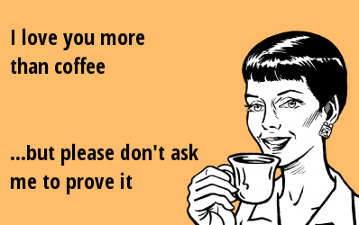
BY FAITH
YOU LOVE THE CHURCH.
Problem today:
“I love you, because I
have to.
But, I don’t like you.”

Slide 5
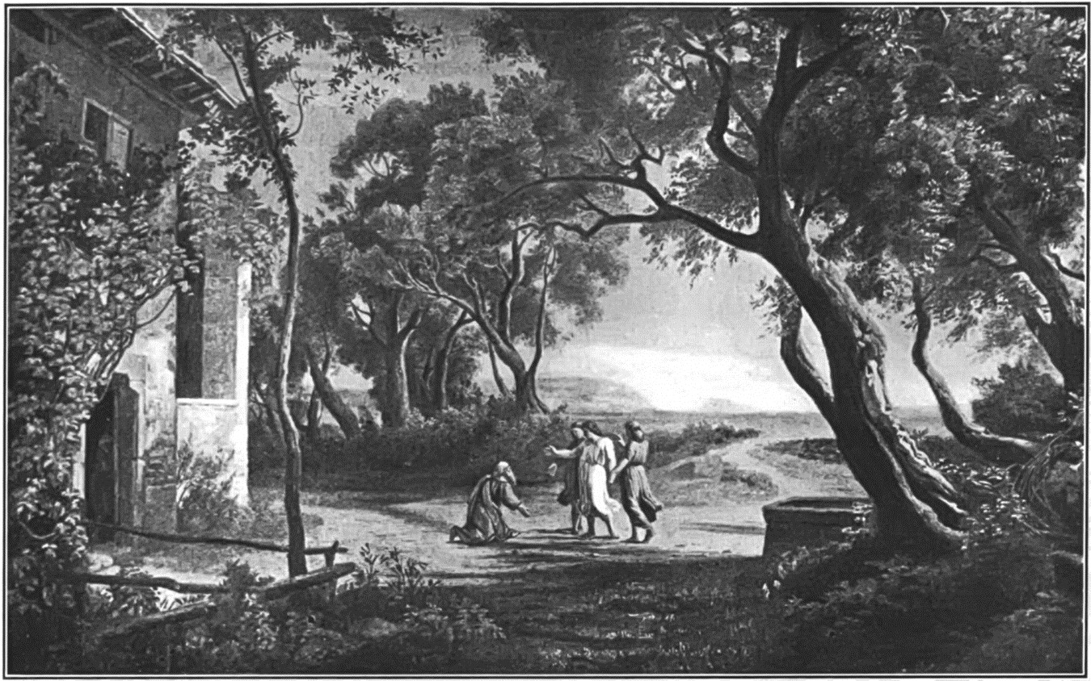
BY FAITH
YOU LOVE THE
STRANGER.

Slide 6
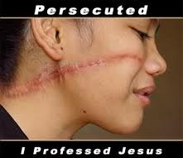
BY FAITH
YOU LOVE THE SUFFERER.

Slide 7
You get a vision for marriage that’s based on God’s relationship with you!

Slide 8
BY FAITH
SUMMARY OF HEB 13:4 –
MARRIAGE AND SEX = PURE GOODNESS!

Slide 9
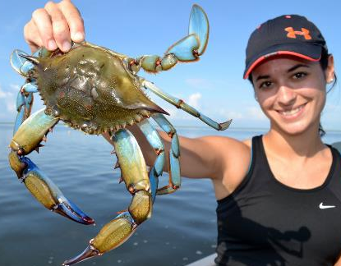
BY FAITH
GOD JUDGES SEXUAL SIN.
HOW?
Sin’s consequences
are built in.

Slide 10
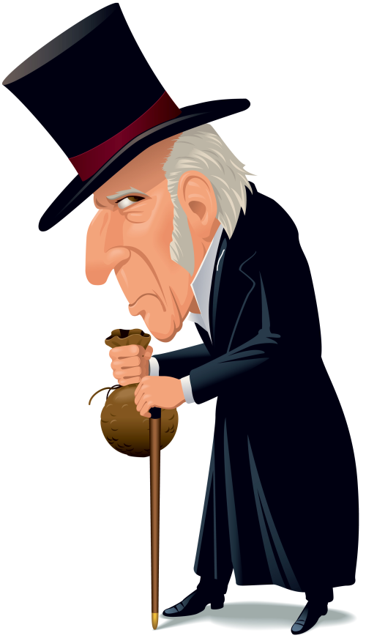
BY FAITH
CONTENTMENT IS KEY!
If you cannot live in contentment with what you have NOW, you will never have enough. It will never be enough!

Slide 11
YOU RECOGNIZE THAT GOD HAS MADE YOU BE ACCOUNTABLE IN HIS LOCAL CHURCH STRUCTURE.
You submit to biblical authority.

Slide 12

BY FAITH
SUBMIT TO FAITHFUL PASTORS.
KEY: Spiritually immature people do not submit to biblical authority.
KEY: All authority comes from God Himself!

Slide 13
Ephesians 1:21-23 Far above all principality, and power, and might, and dominion, and every name that is named, not only in this world, but also in that which is to come: 22 And hath put all things under his feet, and gave him to be the head over all things to the church, 23 Which is his body, the fulness of him that filleth all in all.

Slide 14
Matthew 28:18-20 And Jesus came and spake unto them, saying, All power is given unto me in heaven and in earth. 19 Go ye therefore, and teach all nations, baptizing them in the name of the Father, and of the Son, and of the Holy Ghost: 20 Teaching them to observe all things whatsoever I have commanded you: and, lo, I am with you alway, even unto the end of the world. Amen.

Slide 15
BY FAITH
REMEMBER WHAT THEY HAVE TAUGHT AND MODELED FOR YOU!
In the Word:
2 Peter 1:12 Wherefore I will not be negligent to put you always in remembrance of these things, though ye know them , and be established in the present truth.

Slide 16
BY FAITH
REMEMBER WHAT THEY HAVE TAUGHT AND MODELED FOR YOU!
In their LIFE:
Philippians 3:17-20 Brethren, be followers together of me, and mark them which walk so as ye have us for an ensample. 18 (For many walk, of whom I have told you often, and now tell you even weeping, that they are the enemies of the cross of Christ: 19 Whose end is destruction, whose God is their belly, and whose glory is in their shame, who mind earthly things.) 20 For our conversation is in heaven; from whence also we look for the Saviour, the Lord Jesus Christ:

Slide 17
Principle: We are all to be followers of Christ. Never let anyone lead you to follow them outside of following Christ!

Slide 18
Acts 5:29 Then Peter and the other apostles answered and said, We ought to obey God rather than men.
Colossians 3:18 Wives, submit yourselves unto your own husbands, as it is fit in the Lord.
Eph 6:1 Children, obey your parents in the Lord: for this is right.

Slide 19
BY FAITH
DAD’S: WHAT SHOULD BE TRUE OF ANY PASTOR – HOW THEY RULE, TEACH, AND LIVE OUT THE WORD OF GOD – SHOULD BE TRUE OF YOU IN YOUR HOME.

Slide 20
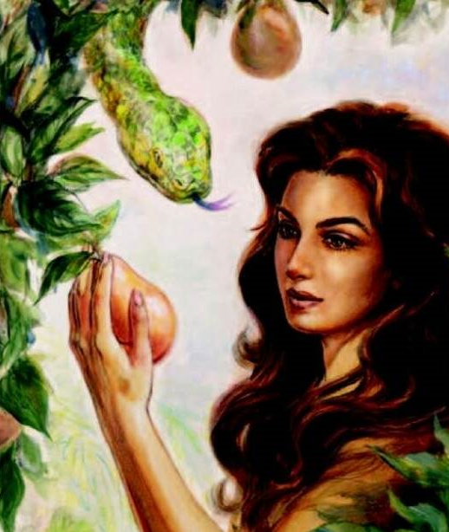
BY FAITH
WHEN GIVING THE WORD, BE CONSISTENT AND FAITHFUL
TO THE DOCTRINE YOU’VE BEEN DELIVERED.
God is consistent and faithful. Vs 8
You be consistent and faithful too! Vs 9!

Slide 21
1 Timothy 4:16 Take heed unto thyself, and unto the doctrine; continue in them: for in doing this thou shalt both save thyself, and them that hear thee.
2 Timothy 1:13 Hold fast the form of sound words, which thou hast heard of me, in faith and love which is in Christ Jesus.

Slide 22
2 Timothy 2:2 And the things that thou hast heard of me among many witnesses, the same commit thou to faithful men, who shall be able to teach others also.
2 Timothy 3:14 But continue thou in the things which thou hast learned and hast been assured of, knowing of whom thou hast learned them;

Slide 23
Titus 1:9 Holding fast the faithful word as he hath been taught, that he may be able by sound doctrine both to exhort and to convince the gainsayers.
2 Thessalonians 2:15 Therefore, brethren, stand fast, and hold the traditions which ye have been taught, whether by word, or our epistle.

Slide 24
Living Faith

